Slide 1


Cognitive Modeling
(information recall from long-term memory)
Itai Pinkoviezky (WIS), Sandro Romani (WIS,CU,Janelia),
Alon Rubin (WIS), Misha Katkov (WIS), Stefano Recanatesi (WIS)
Misha Tsodyks (WIS,CU)
Bennet Murdock (U of Toronto)
Michael Kahana (U Penn)

Slide 2
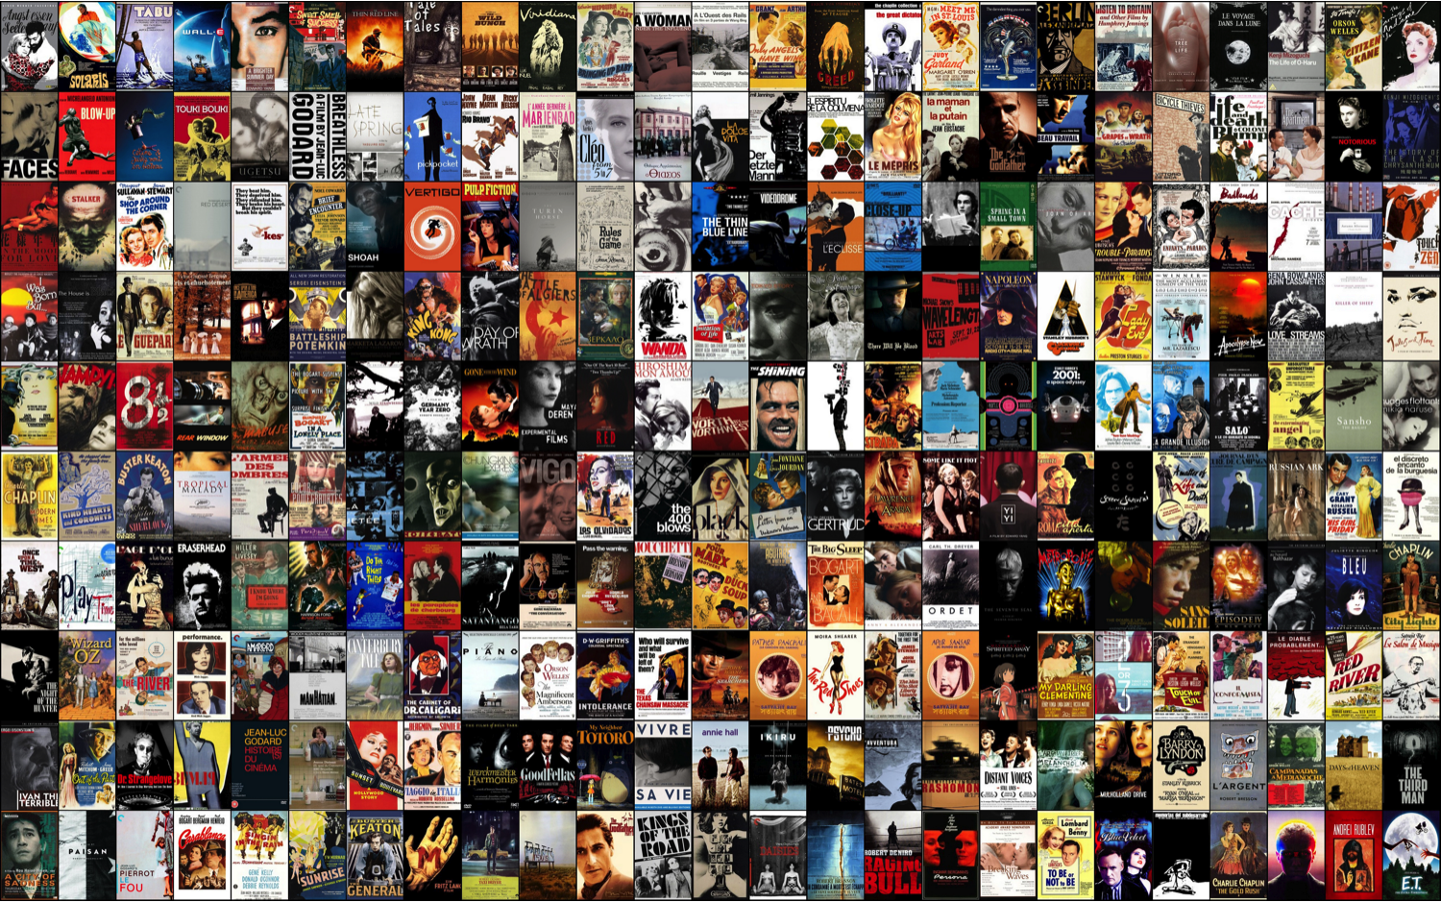
Memory retrieval

Slide 3
Memory retrieval – without cues

Slide 4
Memory retrieval – with cues

Slide 5
Free Recall
Boy
Mountain
3. Job
4. Violin
5. Water
Plane
Monastery
Conference
Goal
Building
Bicycle
Telephone
Suit
Defeat
Table
Engineer

Slide 6
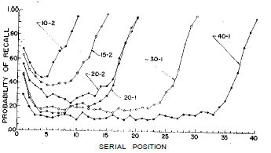

Slide 7
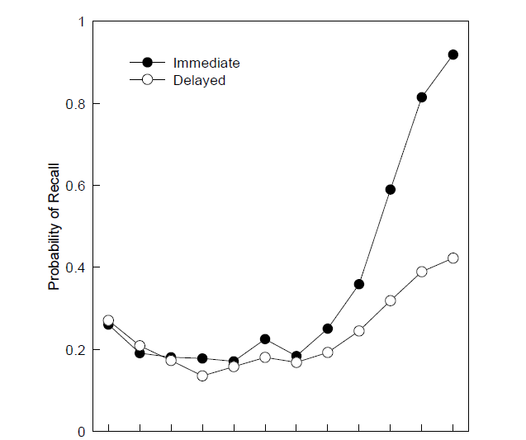
Primacy and recency in free recall
Serial position
Howard & Kahana 1999

Slide 8
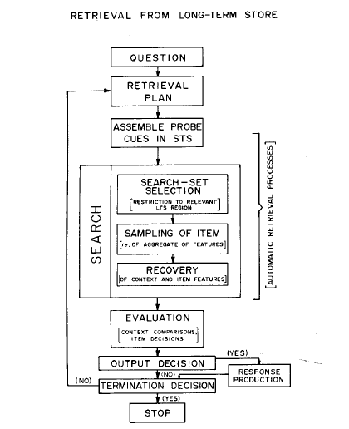
Search of associative memory (Raaijmakers & Shifrin 1980)

Slide 9
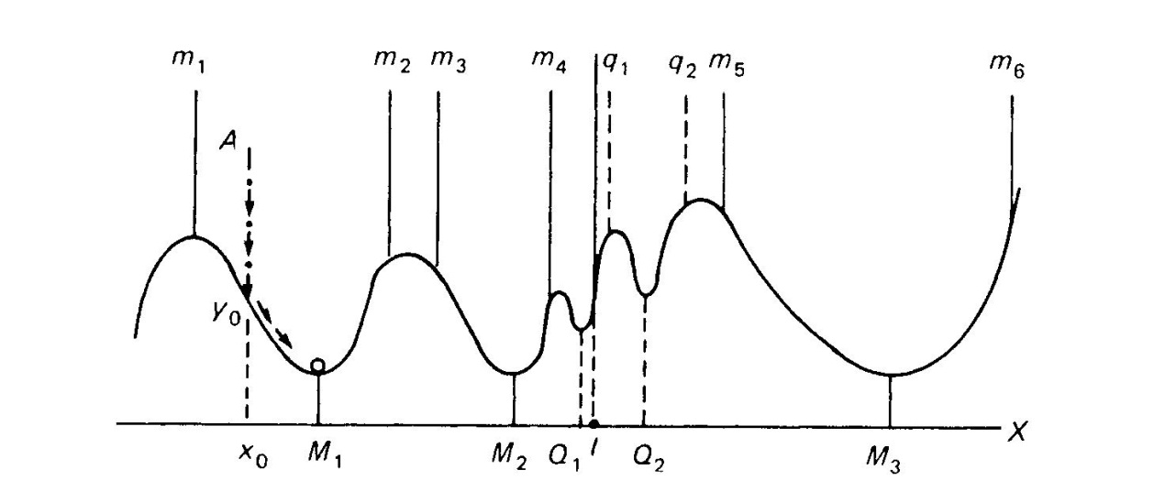
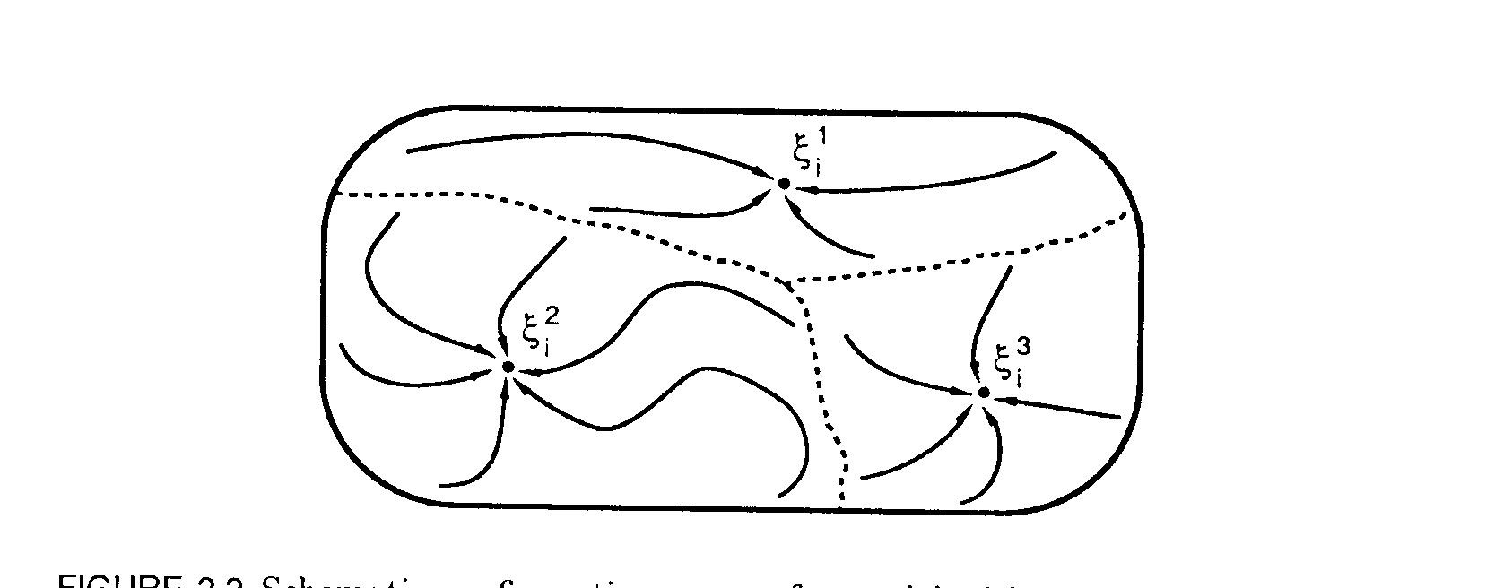
Neural network models of long-term memory (‘Hopfield model’)
Memories are represented as attractors (stable states) of network dynamics.
Attractor = internal representation (memory) of a stimulus
Each attractor: a subset of neurons that has elevated persistent activity.
Synaptic changes => Changes in attractor landscape = changes in memory
Convergence to an attractor = recall of item from memory

Slide 10
Associative memory model (Hopfield 1982)
Neurons ( ):
Connections ( ):
Network dynamics:
Random memory patterns:

Slide 11
Associative memory model (Hopfield 1982)
Storage:

Slide 12
Associative memory model (Hopfield 1982)
Retrieval:

Slide 13
Associative memory model (Hopfield 1982)
Capacity:
Amit et al, Phys. Rev. 1985

Slide 14
Hopfield model with sparse coding (Tsodyks, Feigelman 1988)
Neurons ( ):
Connections ( ):
Network dynamics:
Random memory patterns :

Slide 15
Hopfield model with sparse coding (Tsodyks, Feigelman 1988)
Storage capacity:

Slide 16
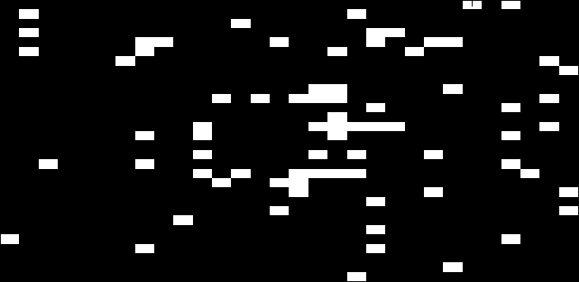
Cue-triggered retrieval

Slide 17
Recognition task
Author
Valley
Bubble
Creature
..
..
Iron
?
Author
Concert

Slide 18
Recognition task
Author
Valley
Bubble
Creature
..
..
Iron
?
Author
Concert

Slide 19
Performance in recognition task
Number of items retained in memory
Number of items in the list
Standing (1973), Q J Exp Psy

Slide 20
Free recall task
Author
Valley
Bubble
Creature
..
..
Iron
Recall as many words as possible
in any order.

Slide 21
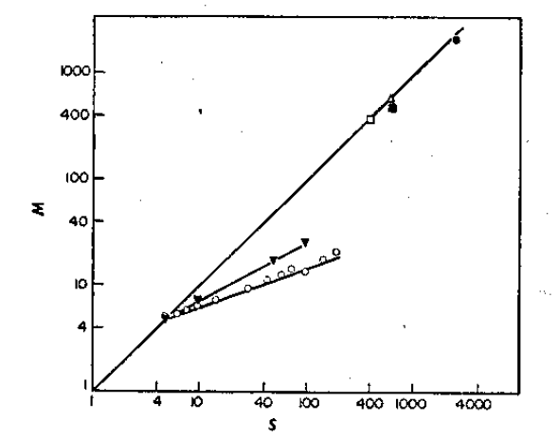
Free recall VS Recognition
Recognition
Free recall
Fig: Standing (1973), Q J Exp Psy. Free Recall: Binet & Henri (1894), Murdock (1960) J Exp Psy

Slide 22
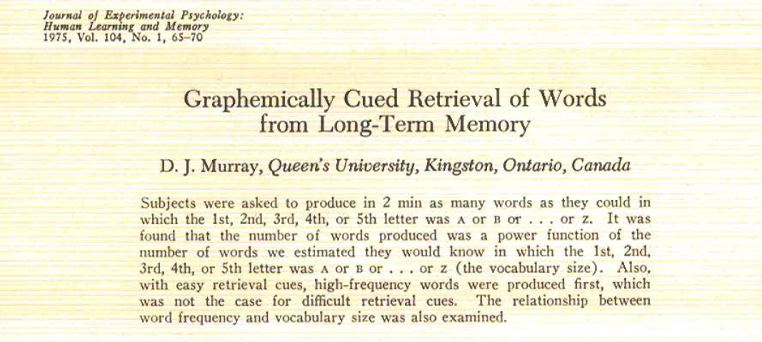

Slide 23
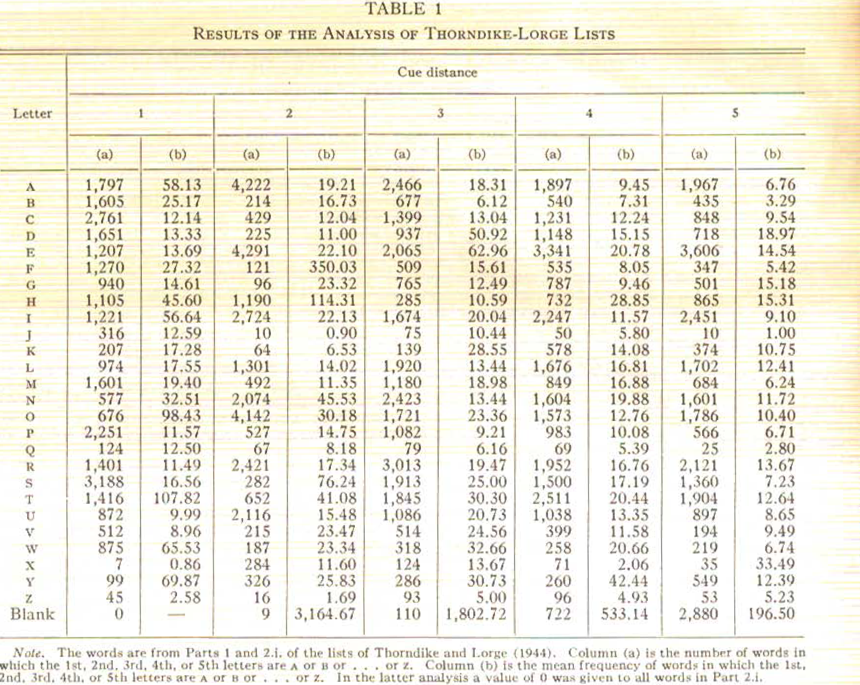

Slide 24
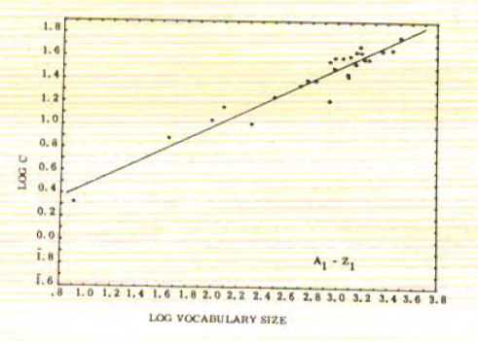
Retrieval from long-term memory – power law

Slide 25
Associative retrieval – attractor neural network model
*) Attractor neural network with sparse coding
(f*N neurons on average encode each item)
*) Periodic modulation of feedback inhibition
*) Adaptation (Single neuron / Synaptic)
Neurons
Items
Romani et al., Neural Computation 2013

Slide 26
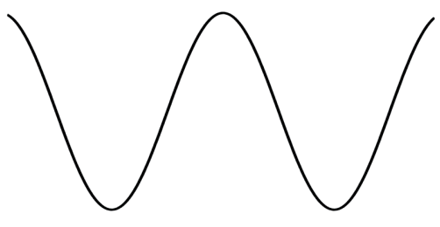
Associative retrieval – attractor neural network model
*) Attractor neural network with sparse coding
(f*N neurons on average encode each item)
*) Periodic modulation of feedback inhibition
*) Adaptation (Single neuron / Synaptic)
Hebbian learning:

Slide 27
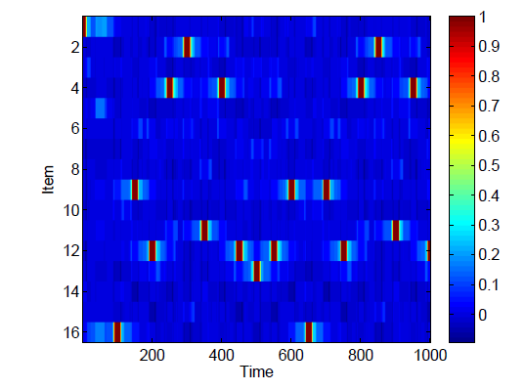
The model – simulations

Slide 28
Associative retrieval: mathematical model

Slide 29
Associative retrieval: graph representation
1
2
3
4
5
6
7
8
9

Slide 30
Associative retrieval: graph representation
1
2
3
?
4
5
6
7
8
9

Slide 31
1. Random asymmetric matrix of similarities: exact solution of the model
1
2
3
4
5
6
7
8
9
All S independent iid
All possible arrows are equally probable

Slide 32
1. Random asymmetric matrix of similarities: exact solution of the model
1
2
3
k
L

Slide 33
1. Random asymmetric matrix of similarities: exact solution of the model
1
2
3
k
L

Slide 34
1. Random asymmetric matrix of similarities: exact solution of the model
1
2
3
k
L

Slide 35
Power law scaling
1
2
3
k

Slide 36
Power law retrieval capacity
1
2
3
k

Slide 37
Power law retrieval capacity
1
2
3
k

Slide 38
Normalized probability distribution

Slide 39
Normalized probability distribution

Slide 40
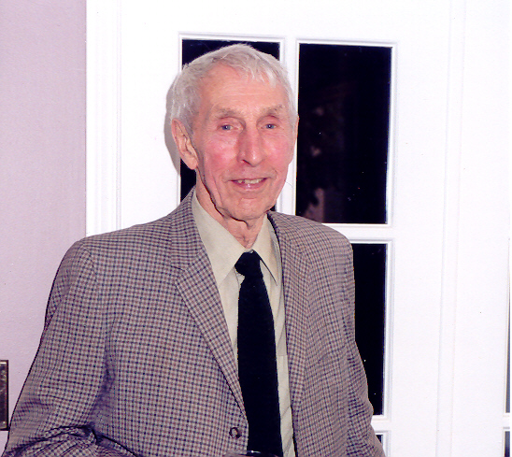
Bennet Murdock
(Toronto)

Slide 41
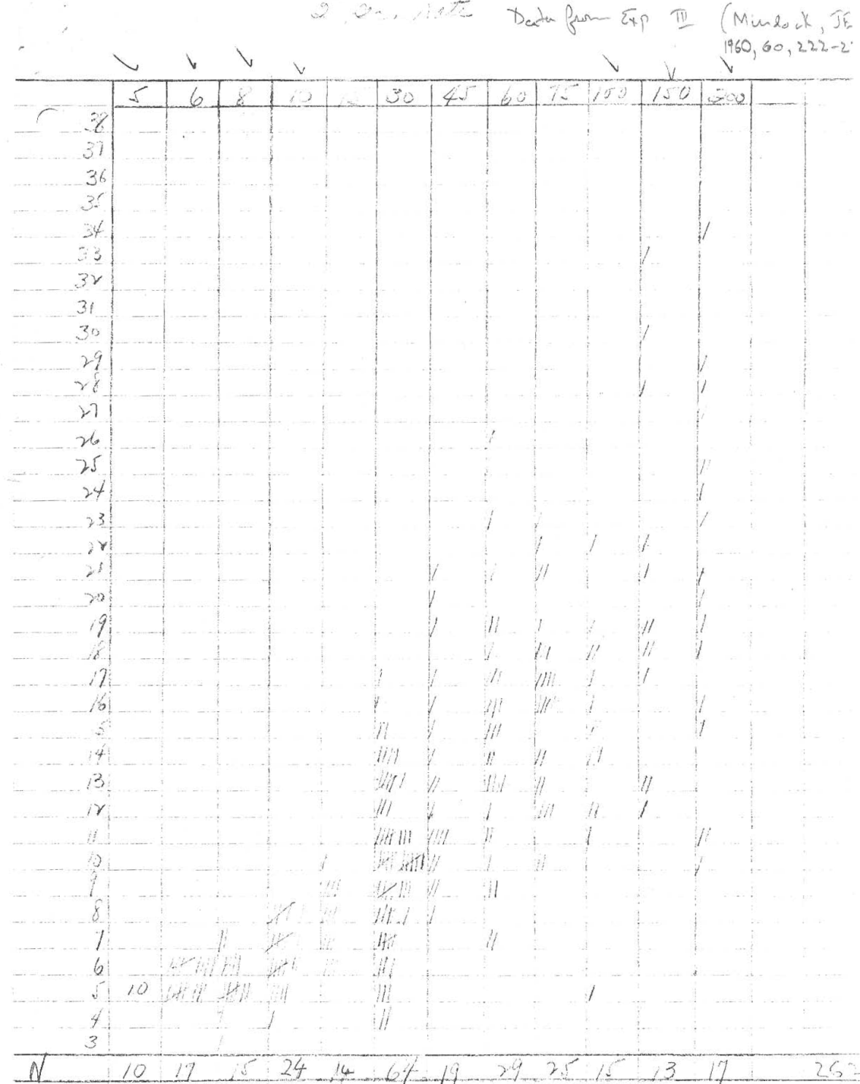
Retrieval capacity: longer lists
Courtesy of B. Murdock

Slide 42
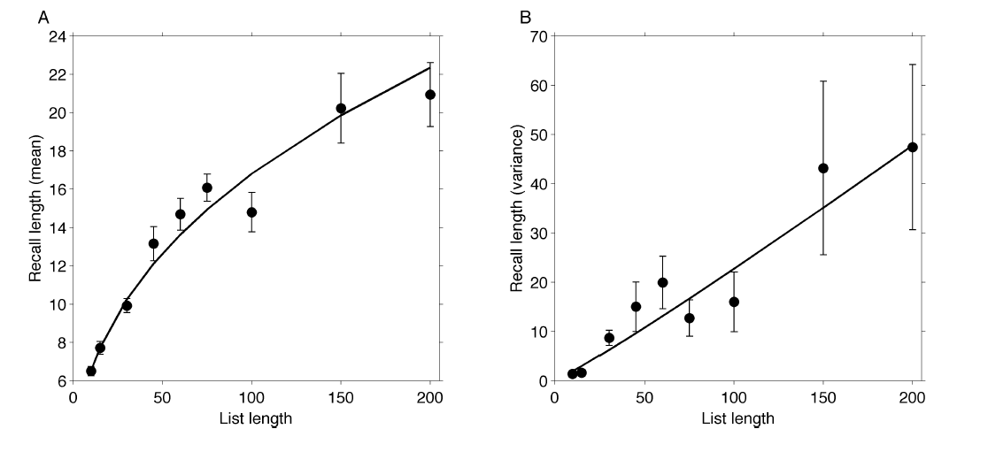
Retrieval capacity: longer lists

Slide 43
Retrieval capacity: longer lists

Slide 44
Conclusions from the simplified model
Accounts for power law scaling of retrieval capacity
Predicts nontrivial scaling of the variance of the number of retrieved words
No free parameters! (All subjects, all memory items are equivalent).

Slide 45
2. Similarities as overlaps between neuronal representation
# of neurons in the intersections between two patterns

Slide 46
2. Similarities as overlaps between neuronal representation
Trapped in two-patterns loop
1
2
Modified dynamics (‘adaptation’):
1
2
3

Slide 47
2. Similarities as overlaps between neuronal representation: effect of modified dynamics
Items recalled: 1 2 3 4 5 6 7 5 4 3 8 9 …
…
5
9
4
6
8
7
1
3
2

Slide 48
2. Similarities as overlaps between neuronal representation
Coding level f determines correlations between matrix entries

Slide 49
Associative retrieval: graph representation
1
2
3
?
4
5
6
8
7
9

Slide 50
Retrieval capacity: power law scaling
1
2
3
k
L

Slide 51
Retrieval capacity: power law scaling
1
2
3
k
L

Slide 52
Retrieval capacity: power law scaling
1
2
3
k

Slide 53
Retrieval capacity: power law scaling
1
2
3
k

Slide 54
Retrieval capacity: power law scaling
1
2
3
k

Slide 55
Retrieval capacity: power law scaling
1
2
3
k

Slide 56
Retrieval capacity: power law scaling
1
2
3
k
L

Slide 57
Retrieval capacity: power law scaling
1
2
3
k
L
Romani et al, Neural Computation 2013

Slide 58
Simulations

Slide 59
Simulations

Slide 60
‘Easy’ vs ‘difficult’ words
Katkov et al, 2015

Slide 61
‘Easy’ vs ‘difficult’ words
Katkov et al, 2015

Slide 62
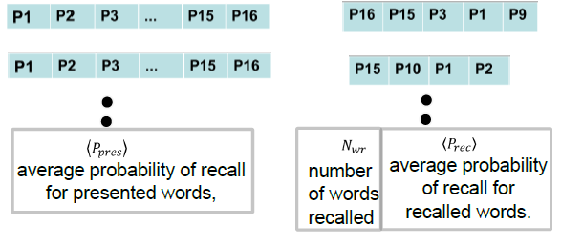
More subtle recall statistics

Slide 63
More subtle recall statistics
Katkov et al, 2015

Slide 64
Interim conclusions/further questions
Universal power laws of associative retrieval of items from
long-term memory without external cues.
Retrieval capacity vs storage capacity
Sparse representations result in larger retrieval capacity
‘Easy’ items may interfere with recall of ‘difficult’ items
Are there ‘easy’ and ‘difficult’ words?

Slide 65
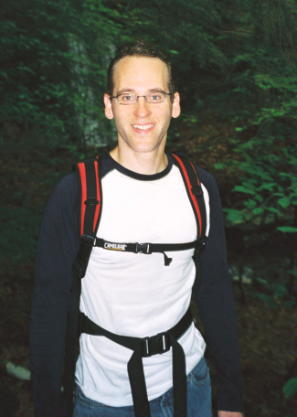
Free recall data set
170 subjects
112 trials/6 sessions per subject
L=16 words per list

Slide 66
Distribution of recall performance across trials

Slide 67
Distribution of recall performance: data vs model

Slide 68
Distribution of recall performance: data vs model
Without recency

Slide 69
Distribution of recall probabilities over a pool of ~1500 words

Slide 70
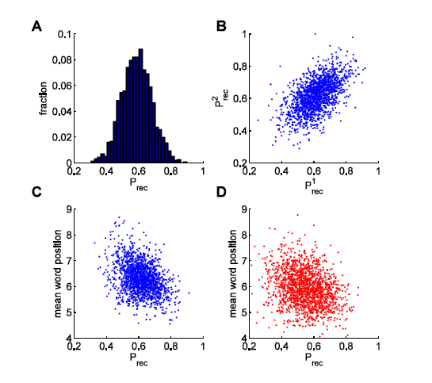
Easy vs difficult words

Slide 71
Recall probability and recall position of the word

Slide 72
Recall statistics: data vs model
Katkov et al, 2015

Slide 73
Towards the model of free recall

Slide 74
Primacy and recency in free recall

Slide 75
Primacy and recency in free recall
Serial position
Howard & Kahana 1999

Slide 76
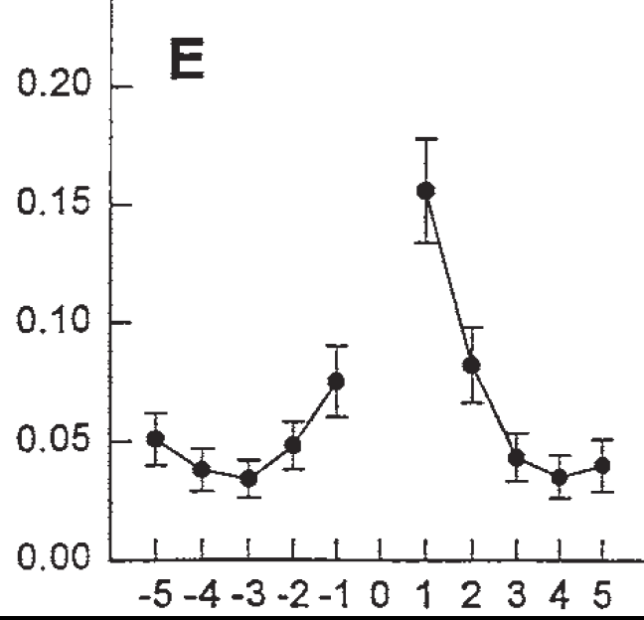
Contiguity
Conditional response probability
Distance from last item recalled
Kahana 1996

Slide 77
Time course of recall

Slide 78
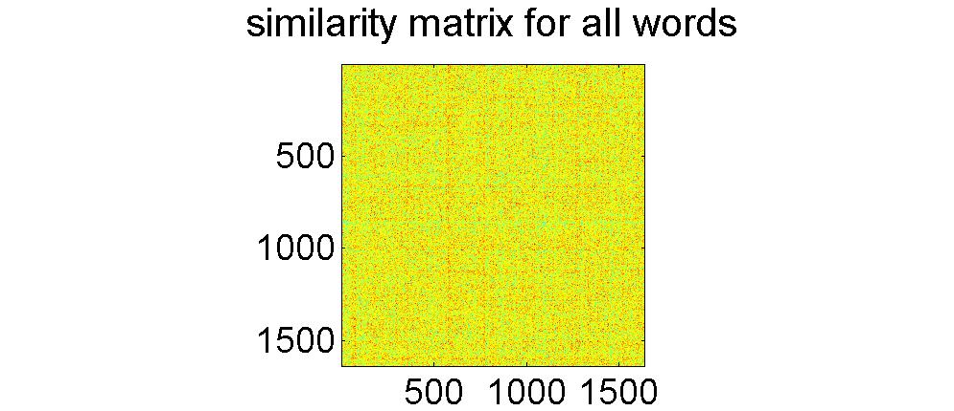
Building the model
Katkov, Romani & Tsodyks, submitted

Slide 79
Similarity matrix for the presented words
 | 1 | 2 | 3 | 4 | 5 | 6 | 7 | 8 | 9 | 10 | 11 | 12 | 13 | 14 | 15 | 16
1
2
3
4
5
6
7
8
9
10
11
12
13
14
15
16

Slide 80
Primacy
 | 1 | 2 | 3 | 4 | 5 | 6 | 7 | 8 | 9 | 10 | 11 | 12 | 13 | 14 | 15 | 16
1
2
3
4
5
6
7
8
9
10
11
12
13
14
15
16

Slide 81
Contiguity
 | 1 | 2 | 3 | 4 | 5 | 6 | 7 | 8 | 9 | 10 | 11 | 12 | 13 | 14 | 15 | 16
1
2
3
4
5
6
7
8
9
10
11
12
13
14
15
16

Slide 82
Full similarity matrix
 | 1 | 2 | 3 | 4 | 5 | 6 | 7 | 8 | 9 | 10 | 11 | 12 | 13 | 14 | 15 | 16
1
2
3
4
5
6
7
8
9
10
11
12
13
14
15
16

Slide 83
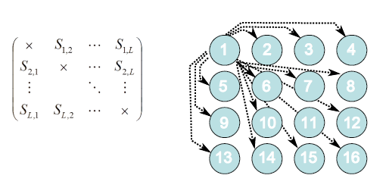
Stochastic retrieval

Slide 84
Free recall model
Katkov et al, 2015

Slide 85
Free recall extended model

Slide 86
Fitting the model to the data
# words recalled
Serial position
Associative recall
Naïve model

Slide 87
Future Directions
1. Universality of scaling laws of recall.
2. Retrieval of hierarchically organized data.
3. Stochasticity of retrieval: time course of recall
4. Neural network implementation
5. Learning to recall (?)

